Slide 1


Lymphogranuloma venereum in men who have sex with men
Henry J.C. de Vries
STI outpatient clinic, Municipal Health Service (GGD) Amsterdam
Dermatology, Amsterdam University Medical Centers, University of Amsterdam

Slide 2
Disclosure
I received money or goods for research, advice or presentations from:
Medigene
Gilead
MSD
Abott
Janssen
Novartis

Slide 3
Concluding remarks:
LGV remains a serious concern for the MSM community
Increase in the prevalence of LGV in Europe
  Clonal, global and focused epidemic within a high risk MSM population
Awareness of, screening for, and prompt treatment of LGV is crucial for the individual patient and to prevent ongoing transmission
  25% (!) asymptomatic LGV infections
Disbalance between the ratio of rectal and non-rectal infections
  Role for ano-oral and transmission routes?
Notes:
LGV infection is a serious concern for the MSM community in Western Europe and other industrialized countries. Awareness of, screening for, and prompt treatment of LGV is crucial for the individual patient and to prevent ongoing transmission. We see a significant increase in the prevalence of LGV in Amsterdam in the last year. Urethral LGV might form a potential undetected reservoir; further surveillance of urethral LGV infections among MSM is warranted and might indicate the need for adjustment of LGV screening and treatment protocols especially for partners of LGV patients.

Slide 4

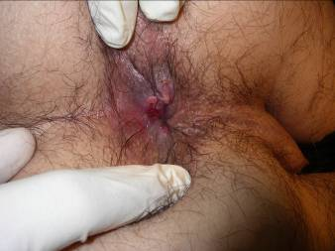
Recent LGV history
Before 2003
After 2003

Slide 5
Recent LGV history 2
Rotterdam LGV case in 2003
LGV L2b, Amsterdam variant
HIV+ MSM multiple anonymous unprotected anal sexual contacts
None associated with LGV endemic area
Severe proctitis, perianal ulcer, unilateral bubo
Chlamydia trachomatis LGV type L2
By April 2003 13 cases
Association with acute hepatitis C infections
Spaargaren et al. Emerg Infect Dis 11: 1090, 2005
Nieuwenhuis RF, et al. Sex. Transm. Infect. 2003

Slide 6
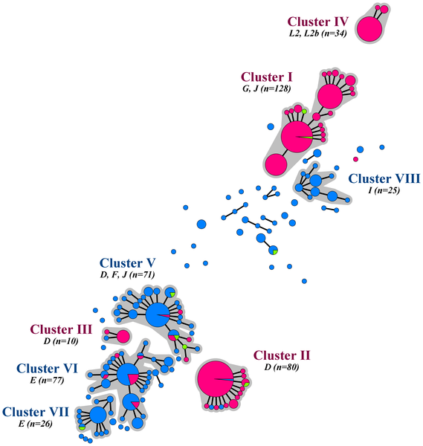
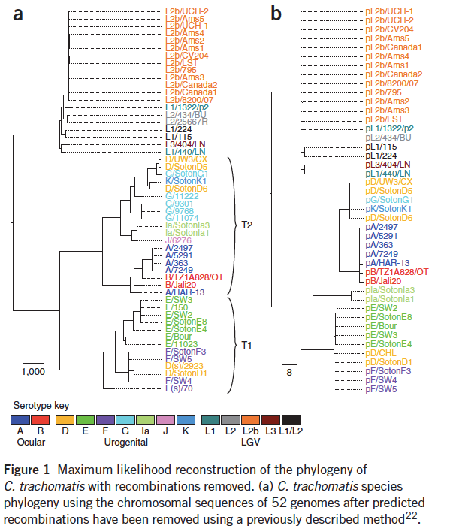
Strains within the LGV clade are considerably less diverse than those in the trachoma lineage
The L2b epidemic is a clonal outbreak that has spread rapidly throughout the world
Distinct Chlamydia trachomatis strains circulate among MSM and heterosexuals
Harris, Nat Genet 2012
Bom RJM PLoS ONE 2013

Slide 7
Chlamydia trachomatis clades and associated diseases
LGV
C. trachomatis L1, L2, L3 (LGV genovar)
invasive
  connective tissue/lymphatics
severe inflammation
usually symptomatic
Urogenital chlamydia
C. trachomatis D-K (trachoma genovar)
non-invasive
  mucosal tissue
mild inflammation
usually asymptomatic
Ocular trachoma: C. trachomatis A-C

Slide 8


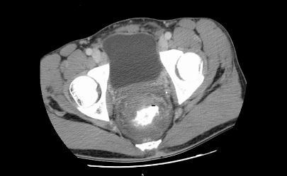
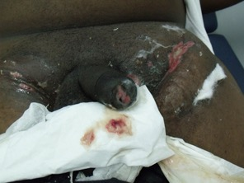
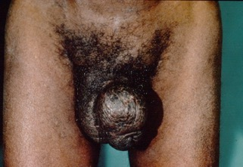
LGV stages
1st stage:
  small short lived ulcer,
  contact site, “porte d’entrée”
2nd stage:
  lymphatic dissemination, bubo’s,
  painful anal cramps, constipation, discharge
  malaise, fever, muscle/joint pains
3rd stage:
  irreversible fibrosis,
  strictures, fistulas, elephantiasis,
  anorectal syndrome, estiomène
Asymptomatic stage
CDC
Notes:
8

Slide 9
LGV: Asymptomatic proctitis
For long, there was the false assumption that LGV infections were symptomatic in the majority of cases.¹
In Amsterdam about a quarter of the anorectal LGV cases did not present with symptoms when screened systematically.^{2,3}
Confirmed in a prospective study performed in the UK: 27% asymptomatic LGV cases in a large nationwide cohort.⁴
  CDC 2015, BASHH 2013 guidelines do not recommend screening of asymptomatic MSM.^{5,6}
  IUSTI 2013 guideline and Public Health England recommend asymptomatic screening.⁷
Screening MSM at risk for LGV proctitis seems rational both from the individual patient perspective as from a public health perspective.
1. Ward H: STI 2009; 2. De Vries HJ STD 2008; 3. De Vrieze NH: STI 2013; 4. Saxon C: EID 2016; 5. White J: IJSA 2013; 6. Workowski KA: MMWR 2015; 7. de Vries HJ: J Eur Acad Dermatol Venereol 2015

Slide 10
Recent LGV epidemiology in Europe
LGV cases for selected EU/EEA Member States,
2005-2014 (ECDC)
LGV infections in MSM, Amsterdam, 2006-2017

Slide 11

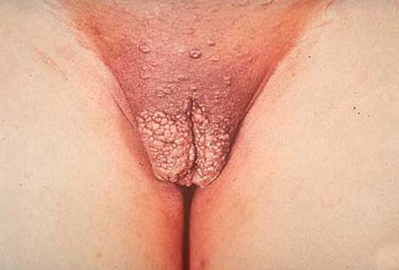
LGV: Urethral and Inguinal infections
Before 2003, LGV was primarily seen in tropical regions in heterosexual men and women
  suppurating inguinal bubo's, also known as inguinal LGV.
In the long run, inguinal LGV disseminates further into the lower pelvic region and leads to late irreversible sequellae
  frozen pelvis syndrome, rectal strictures, fistulas, elephantiasis and esthiomene

Slide 12
The majority of reported LGV infections in MSM after 2003 are found in the anorectal canal and not urogenital
Before 2003:
  Balanced female:male ratio
  Balanced anorectal:inguinal ratio

Slide 13
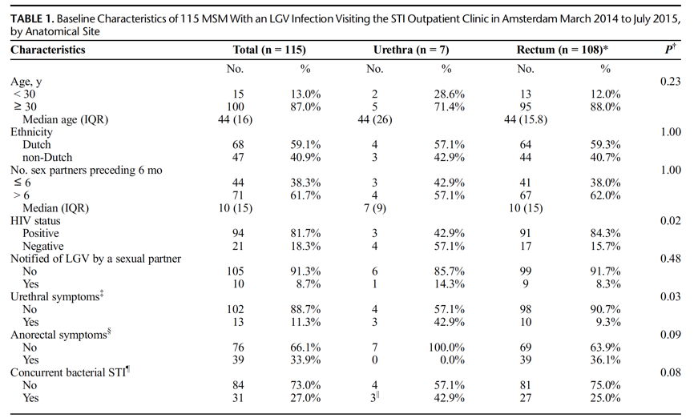
Low prevalence of urethral lymphogranuloma venereum infections among homosexual men visiting the STI clinic in Amsterdam, the Netherlands
Prospectively urethral and anorectal Ct-positive samples were collected from MSM between March 2014 and July 2015.
All TMA (Aptima Combo) positive samples were typed using an in-house pmpH qPCR to differentiate between LGV and non-LGV type infections:
Urethral LGV positivity was 0.06% (7/12.174)
During the same period we found an anorectal LGV-type positivity of 0.9% (109/12.174)
Urethral/Anorectal LGV ratio of 1:15
de Vrieze N: Sex Trans Dis Sept 2017

Slide 14
How to explain the disbalance in the ratio of anorectal and urogenital LGV infections found in MSM?
Tissue tropism (with a higher affinity of LGV serovars to rectal mucosa compared with urethral epithelia) has been suggested, but so far not yet confirmed. ¹⁻³
Sharing toys or fisting practices have been suggested as transmission modes⁴, but subsequently dismissed. ⁵
1. Bax CJ: STI 2011, 2. Jeffrey BM:Infect Immun 2010, 3. Versteeg B: BMC Inf Dis 2014,
4. Nieuwenhuis RF: Clin Inf Dis 2004, 5. Van der Bij A: Clin Inf Dis 2006

Slide 15
Pharyngeal chlamydia infections
Pharyngeal chlamydia was detected in 148/13.111 (1.1%) MSM
  >99% were asymptomatic
  After a median follow-up of 10 days, only 37% of patients with pharyngeal Chlamydia trachomatis had cleared their infection.
Of 23 MSM with pharyngeal chlamydia who had LGV proctitis, or sex with a lymphogranuloma venereum (LGV)-positive partner recently or in the past, two were LGV biovar positive (8.7%).
The pharynx is a reservoir for chlamydia and LGV, and may play a role in ongoing transmission.
Van Rooijen MS: STI 2015

Slide 16
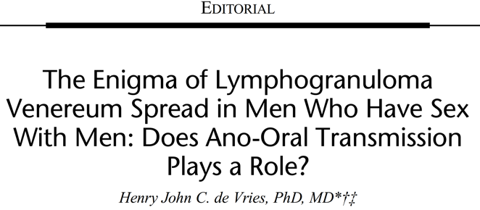
Sex Trans Dis 2016,
“An Alternative Scenario to Explain Rectal Positivity in Chlamydia-Infected Individuals.”¹
  Chlamydiae reside naturally in the GI tract and are transmitted via the fecal-oral route.
  Persist in the GI tract for long periods as a commensal organism.²
Neonates with chlamydia conjunctivitis/pneumonia proceed to shed chlamydia rectally³
Mice infected orally with C. muridarum, become infected in the lower GI-tract and are unable to clear the infection.⁴
  1.Rank: CID 2015, 2. Rank: Infect Immun 2014, 3. Schachter: JID 1979, Igietseme: Infect Immun 2001

Slide 17
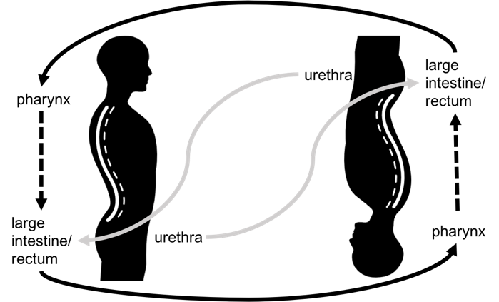
LGV Spread in MSM: Does Ano-Oral Transmission Plays a Role?
Apart from anogenital transmission (gray arrows), oral infection may also occur via ano-oral sex or mechanical transmission (black arrows).
After a subclinical pharyngitis, organisms may pass through the GI tract to induce symptomatic LGV proctitis or asymptomatic infection (dashed arrows); in both cases contributing to the ongoing transmission.
de Vries HJ: Sex Trans Dis 2016

Slide 18

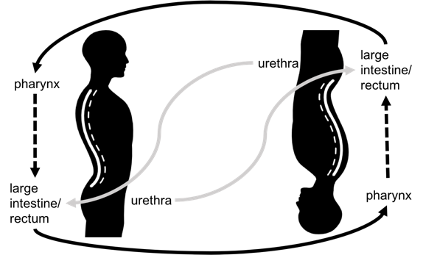

The role of saliva as lubricant in penile-anal sex in the transmission of gonorrhoea and LGV
Traditional and proposed transmission models for gonorrhea in men who have sex with men (MSM)
Internal oro-anal transmission route of LGV
External oro-anal transmission route of LGV
Fairley CK: Emerg Inf Dis 2017
de Vries HJ: Sex Trans Dis 2016

Slide 19
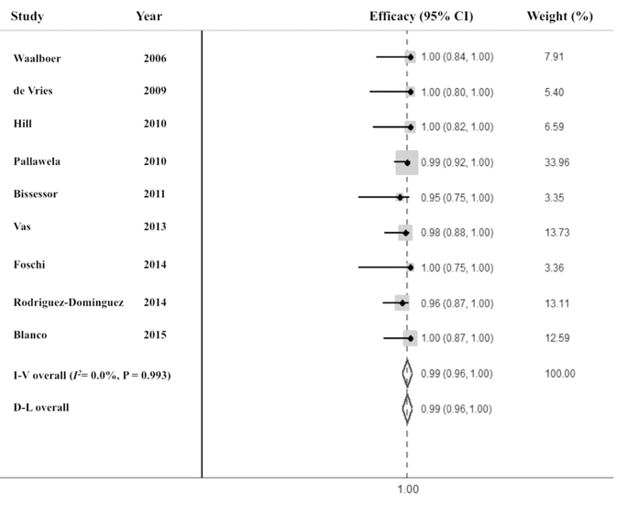
LGV Treatment: Doxycycline 1st line treatment
Meta-analysis 9 RCT’s
The majority of patients (> 80%) had symptomatic rectal infection. The fixed-effects pooled efficacy for doxycycline was 98.5% (95% CI 96.3–100%, I2 = 0%; p = 0.993).
Doxycycline 100 mg twice daily for 21 days demonstrated a high microbial cure rate, supporting its use as first line therapy for rectal LGV in MSM.
Leeyaphan C: Emerg Inf Dis 2016

Slide 20
Concluding remarks:
LGV remains a serious concern for the MSM community
Increase in the prevalence of LGV in Europe
  Clonal, global and focused epidemic within a high risk MSM population
Awareness of, screening for, and prompt treatment of LGV is crucial for the individual patient and to prevent ongoing transmission
  25% (!) asymptomatic LGV infections
Disbalance between the ratio of rectal and non-rectal infections
  Role for ano-oral and transmission routes?
Notes:
LGV infection is a serious concern for the MSM community in Western Europe and other industrialized countries. Awareness of, screening for, and prompt treatment of LGV is crucial for the individual patient and to prevent ongoing transmission. We see a significant increase in the prevalence of LGV in Amsterdam in the last year. Urethral LGV might form a potential undetected reservoir; further surveillance of urethral LGV infections among MSM is warranted and might indicate the need for adjustment of LGV screening and treatment protocols especially for partners of LGV patients.

Slide 21

stihiv2021.org

